Slide 1
Mobile IP
Entities and terminology
● Mobile node (MN):
A mobile node is an end-system or router that can
change its point of attachment to the internet using mobile IP.
The MN keeps its IP address and can continuously communicate with any other system in the internet as long as link-layer connectivity is given.
MN : laptops with antennas ,mobile phones; a router onboard an aircraft

Slide 3
Mobile IP (Entities and terminology)
Correspondent node (CN): At least one partner is needed for communication.
The CN can be a fixed or mobile node.
● Home network: The home network is the subnet the MN belongs to with respect to its IP address.
No mobile IP support is needed within the home network.

Slide 4
Mobile IP (Entities and terminology)
Foreign network: The FN is the current subnet the MN visits and which is not the home network.
Foreign agent (FA): The FA can provide several services to the MN during its visit to the FN
FA can have the COA acting as tunnel endpoint and forwarding packets to the MN.
FA - default router
FA - security services
FA is implemented on a router for the subnet the MN attaches to

Slide 5
Mobile IP (Entities and terminology)
● Care-of address (COA): The COA defines the current location of the MN from an IP point of view.
IP packets - to - MN –COA- not IP address of the MN
Packet delivery toward the MN is done using a tunnel
COA - tunnel endpoint - address where packets exit
There are two different possibilities for the location of the COA:

Slide 6
Mobile IP (Entities and terminology)
● Care-of address (COA): There are two different possibilities for the location of the COA:
● Foreign agent COA: -
located at the FA, i.e., the COA - IP address of the FA
The FA - tunnel end-point – forwards packets to MN
Many MN using the FA can share this COA as
common COA.
● Co-located COA:
The COA is co-located if the MN temporarily acquired
an additional IP address which acts as COA.

Slide 7
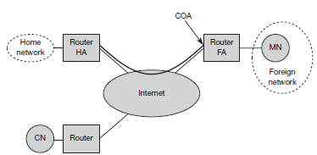
Home agent (HA):
HA - several services - MN – located in the home network
The tunnel for packets toward the MN starts at the HA
HA -a location registry, i.e., it is informed of the MN’s location by the current COA

Slide 8
Home agent (HA):
3 alternatives for the implementation of an HA exist
● The HA - on a router - for the HN
This - best position - because without optimizations to mobile IP, all packets for MN -through the router anyway.
● The HA - on an arbitrary node in the subnet
One disadvantage - double crossing of the router by the packet if the MN is in a foreign network
The HA - on the ‘router’ but - as a manager for MNs belonging to a virtual home network.

Slide 9
CN - via a router to the internet, as are the HN and FN
HA - on the router connecting the HN
FA -on the router to the FN
MN is currently in foreign network
The tunnel for packets toward the MN starts at the HA and ends at the FA, for the FA has the COA in this example.

Slide 10


Example network
mobile end-system
Internet

Slide 11
Data transfer to the mobile system
Internet

Slide 12
Data transfer from the mobile system
Internet

Slide 13
IP packet delivery
Fig 8.2 illustrates packet delivery to and from the MN
Q1> Explain the Packet Delivery with respect to Mobile IP.
Q2> How is Packet delivery achieved to and from Mobile Node?

Slide 14
Overview of Packet delivery to and from MN
router HA
router FA
3.
home network
2.
MN
4.
Internet
foreign network
1.
router
CN
R. Wattenhofer

Slide 15
A correspondent node CN wants to send an IP packet to the MN
CN – doesn’t - MN’s current location - sends packet as usual to the IP address of MN (step 1)
CN sends an IP packet with MN as a destination address and CN as a source address
The internet routes the packet to the router responsible for the home network of MN
The HA now intercepts the packet, knowing that MN is currently not in its home network.

Slide 16
The packet is not forwarded into the subnet,
but encapsulated and tunneled to the COA
A new header is put in front of the old IP header showing the COA as new destination and HA as source of the encapsulated packet (step 2)
The foreign agent now de-capsulates the packet, i.e., removes the additional header, and forwards the original packet with CN as source and MN as destination to the MN (step 3)

Slide 17
Again, for the MN mobility is not visible
It receives the packet with the same sender and receiver address as it would have done in the home network.
The MN sends the packet as usual with its own fixed IP address as source and CN’s address as destination (step 4).
If CN were also a mobile node residing in FN, then
steps 1 through 3 would apply now in the other direction.

Slide 18
Agent discovery
Initial problem - MN - to find a foreign agent
How - MN discover that it has moved?
Agent advertisement
Agent solicitation
Q1> Explain Agent advertisement in Mobile IP.
Q2> How the agent could be discovered using Mobile IP? Give the overlays of agent advertisement packet which includes mobility extension.

Slide 19
Agent discovery
Agent advertisement
FA and HA -advertise their presence periodically using special agent advertisement messages
For these advertisements Internet control message protocol (ICMP) messages are used
The agent advertisement packet according to RFC 1256 with the extension for mobility is shown in Figure 8.3

Slide 20
The upper part represents the ICMP packet
while the lower part is the extension needed for mobility.

Slide 21
Agent discovery
Agent advertisement
The TTL (Time To Live)field of the IP packet is set to 1 for all advertisements to avoid forwarding
The IP destination address according to standard router advertisements can be either set to 224.0.0.1, which is the multicast address for all systems on a link
or to the broadcast address 255.255.255.255

Slide 22
The fields in the ICMP part are defined as follows
type - 9
code - 0, if agent routes traffic from non-mobile nodes or
code -16, if it routes traffic from mobile nodes
#addresses -Number of addresses advertised
Lifetime - length of time advertisement is valid
Preference levels - for each address help a node to choose the router that is the most eager one to get a new node.

Slide 23
Extension for mobility has following fields:
type - 16
length -depends on number of COAs provided with the message and equals 6 + 4*(number of addresses)
Sequence number - total number of advertisements sent since initialization by the agent
registration lifetime the agent can specify the maximum lifetime in seconds a node can request during registration
The following bits specify the characteristics of an agent in detail.

Slide 24
R bit (registration) - if a registration with this agent is required even when using a co-located COA at MN
B bit - Agent is currently too busy to accept new registrations
H bit - the agent offers services as a home agent
F bit - the agent offers services as an foreign agent
M bit - minimal encapsulation
G bit - generic routing encapsulation
r bit - set to zero and must be ignored
T bit - indicates that reverse tunneling

Slide 25
2) Agent solicitation:
Agent solicitation message are sent by MN it self to search an FA under following conditions:
i>If no agent advertisements are present
Ii>The inter-arrival time is too high
Iii>MN has not received a COA by other means
The mobile node must send agent solicitations
MN can search for an FA endlessly sending out solicitation messages
Solicitation messages do not flood the network because MN can send out 3 solicitation per second as soon as it enters a new network.

Slide 26
Agent solicitation Continue…..
If MN node doesn’t receive an answer to its solicitations it must decrease the rate of solicitations exponentially to avoid flooding the network
Any agent that receives the solicitation message must transmits a single Agent advertisement in response.
After these steps of advertisements or solicitations the MN can now receive a COA, either one for an FA or a co-located COA
The MN knows its location (HN or FN) and the capabilities of the agent
The next step for the MN is the registration with the HA if the MN is in a foreign network

Slide 27
Registration
Having received a COA, MN has to register with HA
Main purpose of the registration is to inform HA of the current location for correct forwarding of packets
Registration can be done in two different ways depending on the location of the COA
● If the COA is at the FA, registration is done as illustrated in Figure (left)
The MN sends its registration request containing the COA (see Figure) to the FA which is forwarding the request to the HA.

Slide 28
Registration
COA @ FA:
COA @ MN:
MN
FA
HA
MN
HA
registration
registration
request
request
registration
request
registration
reply
registration
reply
t
registration
reply
t
R. Wattenhofer

Slide 29
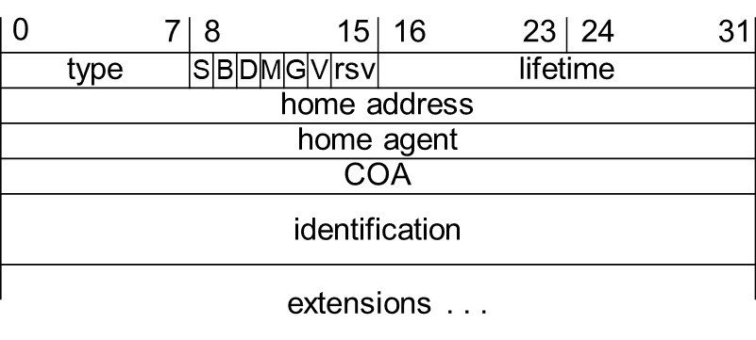
Mobile IP registration request Packet
R. Wattenhofer

Slide 30
Registration
The HA now sets up a mobility binding containing the MN’s home IP address and the current COA
Additionally, it contains the lifetime of the registration
MN should reregister before expiration
After setting up the mobility binding, HA sends a reply message back to the FA which forwards it to the MN.
● If the COA is co-located, registration can be simpler, as shown in Figure (right)
The MN may send the request directly to the HA and vice versa. This is also the registration procedure for MNs returning to their home network.

Slide 31
Registration
Here they also register directly with the HA
If MN received agent advertisement from FA it should register via this FA if R bit is set in the advertisement
UDP(User Datagram Protocol) packets are used for registration requests
IP source address is set to interface address of the MN
IP destination address is that of the FA or HA
UDP destination port is set to 434
Fields relevant for mobile IP registration requests follow as UDP data are defined as follows

Slide 32
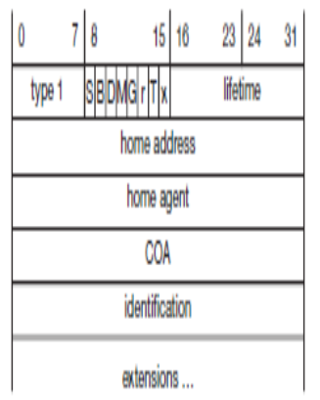


Slide 33

type is set to 1 for a registration request
S bit – MN can specify if it wants the HA to retain prior mobility bindings
B bit - an MN also wants to receive the broadcast packets which have been received by the HA in HN
D bit - If MN uses a co-located COA, it also takes care of the de-capsulation at the tunnel endpoint
M and G denote the use of minimal encapsulation or generic routing encapsulation
T indicates reverse tunneling
r and x are set to zero.

Slide 34
Lifetime denotes validity of registration in seconds
Value of zero indicates deregistration
home address is the fixed IP address of the MN
home agent is the IP address of the HA
COA represents the tunnel endpoint. The 64 bit identification is generated by the MN.

Slide 35
Registration Reply Message Details
A registration reply, which is conveyed in a UDP packet, contains a type field set to 3
code indicating the result of the registration request. Given in Table next slide.
Lifetime denotes validity of registration in seconds.
Extensions: It contains parameters for authentication and may also contain other information as required.

Slide 36
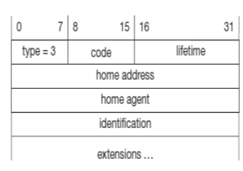
Registration
Reply

Slide 37
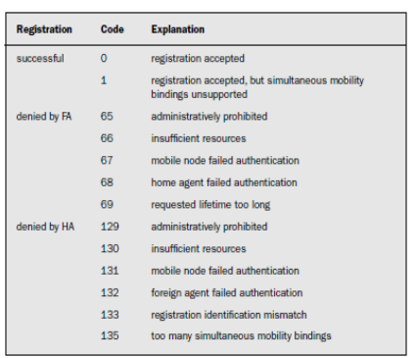
Example
Registration
Reply Codes

Slide 38
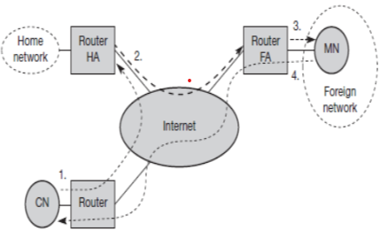
Tunneling and encapsulation
In the Figure below, step 2, describes the mechanisms used for forwarding packets between the HA and the COA
Packet delivery to and from the Mobile Node

Slide 39
Tunneling and encapsulation
A tunnel establishes a virtual pipe for data packets between a tunnel entry and a tunnel endpoint
Packets entering a tunnel are forwarded inside the tunnel and leave the tunnel unchanged

Slide 40
Tunneling and encapsulation (contd.)
Tunneling is achieved by using encapsulation.
Encapsulation is the mechanism of taking a packet consisting of packet header and data and putting it into the data part of a new packet.
The reverse operation or de-capsulation is taking a packet out of the data part of another packet.
Encapsulation and de-capsulation operations are performed when a packet is transferred from a higher protocol layer to a lower layer or from a lower to a higher layer respectively

Slide 41
Tunneling and Encapsulation
 | original IP header | original data
new IP header | new data
outer header | inner header | original data
R. Wattenhofer

Slide 42
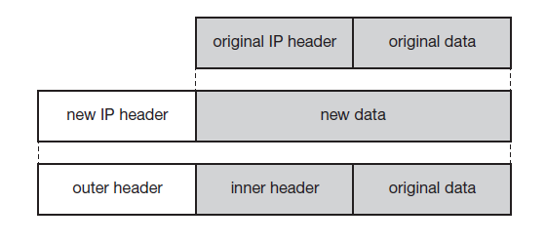
Tunneling and encapsulation (contd.)
This mechanism is shown in the figure below
IP Encapsulation HA takes original packet with the MN as destination, puts it into the data part of a new packet and
Sets new IP header in such a way that the packet is routed to the COA
New header is called outer header
Inner header which can be identical to the original header
This is the case for IP-in-IP encapsulation

Slide 43
IP-in-IP Encapsulation
Mandatory in RFC 2003
tunnel between HA and COA
ver. | IHL | TOS | length
IP identification |  |  | flags | fragment offset
TTL |  | IP-in-IP | IP checksum
IP address of HA
Care-of address COA
ver. | IHL | TOS | length
IP identification |  |  | flags | fragment offset
TTL |  | lay. 4 prot. | IP checksum
IP address of CN
IP address of MN
TCP/UDP/ ... payload
R. Wattenhofer

Slide 44
IP-in-IP Encapsulation
Various fields in outer header are:
ver: Version field denotes the version number and set 4 for IPv4.
IHL(Internet Header Length): indicates the length of outer header.
DS(TOS): Copied from inner header
length: It denotes the complete length of an encapsulated packet.
TTL(Time To Live): Indicates the period of validity of the packet.
IP-in-IP: Denotes the type of protocol used in IP payload. Set to 4, protocol type is IPv4.
IP checksum: This is used for error detection mechanism.
IP address of HA: Tunnel entry point as source address.
Care of address of COA: Tunnel exit point as destination address.

Slide 45
IP-in-IP Encapsulation continue….
The fields of the inner header are same as the outer header. This header remains almost unchanged during encapsulation.
The only change is TTL which is decremented by 1. This means that the whole tunnel considered a single hop from the original packet’s point of view.
TCP/UDP payload contains the actual data to be transmitted.
Advantage:
It is simple to implement and it is a default encapsulation mechanism.
Disadvantage:
Most of the outer header fields are same as inner header so this method increase redundancy.

Slide 46
Minimal Encapsulation
optional
avoids repetition of identical fields such as TTL, IHL, version, TOS
only applicable for unfragmented packets, no space left for fragment identification
ver. | IHL | TOS |  | length
IP identification |  |  |  | flags | fragment offset
TTL |  | min. encap. |  | IP checksum
IP address of HA
care-of address COA
lay. 4 protoc. |  | S | reserved | IP checksum
IP address of MN
IP address of CN (only if S=1)
TCP/UDP/ ... payload
R. Wattenhofer

Slide 47
Minimal Encapsulation
It is defined in RFC 2004. It involves fewer fields in IP packet. It can be used if HA, MN and FA all agree to use.
The outer header fields are almost same as IP encapsulation the only difference is in the TYPE field. It is set to 55.
Inner header much smaller than IP encapsulation packet.
The S bit indicates whether the original sender address is included in the header or not. Value 0 indicates sender address can be omitted.
Advantages: Lower overhead as compared to IP-in-IP encapsulation as it avoids redundancy.
Disadvantage: It does not support fragmentation to deal wit tunnel with smaller path.

Slide 48
Generic Routing Encapsulation
 |  | original header | original data
outer header | GRE header | original header | original data
new header | new data
ver. |  |  |  | IHL |  | TOS |  | length
IP identification |  |  |  |  |  |  |  | flags | fragment offset
TTL |  |  |  |  |  | GRE |  | IP checksum
IP address of HA
Care-of address COA
C | R | K | S | s | rec. | rsv. | ver. | protocol
checksum (optional) |  |  |  |  |  |  |  | offset (optional)
key (optional)
sequence number (optional)
routing (optional)
ver. |  |  |  | IHL |  | TOS |  | length
IP identification |  |  |  |  |  |  |  | flags | fragment offset
TTL |  |  |  |  |  | lay. 4 prot. |  | IP checksum
IP address of CN
IP address of MN
TCP/UDP/ ... payload

Slide 49
Generic Routing Encapsulation
GRE is defined in RFC 1701. GRE mechanism developed before the development of mobile IP.
GRE allows the encapsulation of packets of one protocol suite into the payload portion of a packet of another protocol suite.
GRE header is prepended to the packet of one protocol suite with original header data.
Various fields of GRE header are described as follows:
Protocol Type: is set to 47 for GRE encapsulation
C bit: If C bit is set, checksum field contain the valid IP checksum of GRE header & payload
R bit: if set, it indicates that the offset and routing fields are present and contain valid info.
K bit: If it is set, indicates the key field is present and may be used for authentication.
S bit: if set, indicates the sequence number field is present
s bit: if set, indicates that the strict source routing is used.
rec. (recursion control): It represents a counter that shows the number of allowed recursive encapsulation.
rsv. (reserved): this field is reserved for future use and must be set to zero.
ver. (version): It is set to 0 for GRE version.
Protocol: Indicates the protocol used by the packet following GRE header.

Slide 50
Generic Routing Encapsulation continue..
Checksum: Contain valid IP checksum of the GRE header and payload
(present only when C bit is set)
Offset: It represents the offset in bytes for the first source routing.
(present only when R bit is set)
Key: Contains a key that can be used for authentication.
(present only when K bit is set)
Routing: It is variable length and contains the fields for source routing.
Advantages:
GRE supports other network layer protocol in addition to IP
It allows more than one level of encapsulation.

Slide 51
Reverse tunneling (RFC 3024, was: 2344)
HA
2
MN
Internet
home network
1
sender
FA
foreign
network
1. MN sends to FA
2. FA tunnels packets to HA
by encapsulation
3. HA forwards the packet to the
receiver (standard case)
3
CN
receiver

Slide 52
Mobile IP with reverse tunneling
Router accept often only “topological correct“ addresses (firewall!)
  a packet from the MN encapsulated by the FA is now topological correct
  furthermore multicast and TTL problems solved (TTL in the home network correct, but MN is to far away from the receiver)
Reverse tunneling does not solve
  problems with firewalls, the reverse tunnel can be abused to circumvent security mechanisms (tunnel hijacking)
  optimization of data paths, i.e. packets will be forwarded through the tunnel via the HA to a sender (double triangular routing)
The standard is backwards compatible
  the extensions can be implemented easily and cooperate with current implementations without these extensions
  Agent Advertisements can carry requests for reverse tunneling

